Slide 1
Introduction to Computer Science
Day 4

Slide 2
Chapter 13
Simulation and Modeling

Slide 3
Computational Modeling
Science involves forming hypotheses and performing experiments to test them
A model is a representation of a real system that acts like the real thing in important ways
Experimenting with a model may be preferred
Physical models are physical objects
Computational models are simulations
Equations and algorithms inside a computer
Also called simulation models

Slide 4
Computational Modeling (cont'd.)
Why experiment on a simulation model?
Existence: real system may not exist yet
Physical realization: system may not be made of physical things (e.g., social systems)
Safety: system may be unsafe to experiment with (e.g., nuclear reactor design)
Speed of construction: physical model may take too long to build

Slide 5
Computational Modeling (cont'd.)
Why experiment on a simulation model?
Time scale: physical system may happen too fast or too slow to experiment
Ethical behavior: experimenting on physical system may be ethically wrong
Ease of modification: can change the model quickly and easily

Slide 6
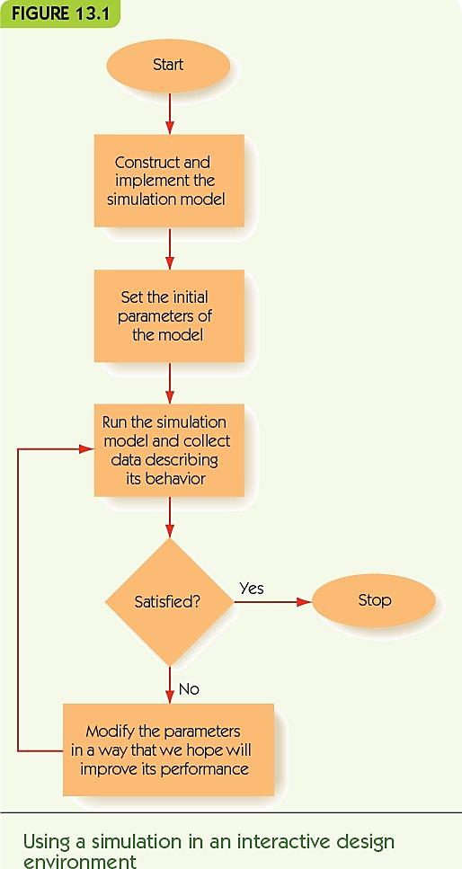
Computational Modeling (cont'd.)
Computational steering
Repeat until satisfied with design:
Build simulation model of design
Test and experiment on model
Refine design
Used for the design of brand-new systems

Slide 7
Computational Modeling (cont'd.)
Models balance between accuracy and complexity
All models include some features and omit others
Example: model of falling mass
d = v_{init} t + ½ g t²
Omits effects of air resistance
Assumes constant gravity
Continuous model: a formula based on continuous time
Stochastic components: elements of randomness

Slide 8
Computational Modeling (cont'd.)
Discrete event simulation
Model time as discrete time steps
Events: activities that change the state of system
Examples: customer enters store, customer purchases item, customer leaves store
Simulate only times where events take place
Keep a list of events and their scheduled times
Repeat:
Advance time to time of next event
Skip any intervening time steps
Perform next event’s actions

Slide 9
Computational Modeling (cont'd.)
Example simulation: McBurger
Determine how many checkout stations for a fast food restaurant
Single line of customers
N server stations
If server is free, next customer goes
Server is busy while customer orders, waits, and pays

Slide 10
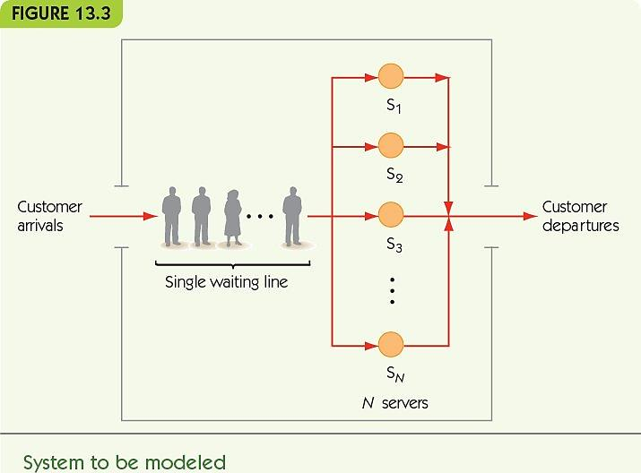
Computational Modeling (cont'd.)

Slide 11
Computational Modeling (cont'd.)
Example simulation: McBurger
Events in this model
Customer arrives
Adds to line or makes idle server busy
Customer departs
Removes customer from line or makes server idle
Construct algorithms for each event
Update state of simulation for event
Record data to be collected

Slide 12
Computational Modeling (cont'd.)
Example simulation: McBurger
For each customer, record:
Time spent waiting (T_{depart} – T_{arrive} – T_{serve})
Time being served (T_{serve})
For each server, record:
Total time spent serving

Slide 13
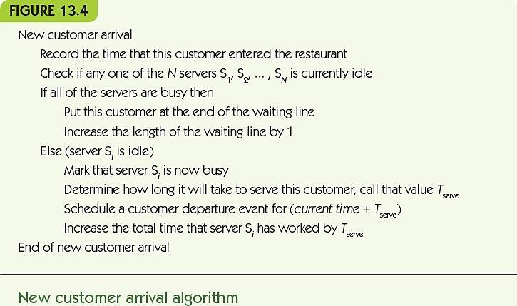
Computational Modeling (cont'd.)

Slide 14
Computational Modeling (cont'd.)
Example simulation: McBurger
Time being served, T_{serve}, is stochastic
Generate based on statistical distribution
Equation that captures probabilities of different values occurring
Derive distribution from external sources
Other restaurants
Garbage in, garbage out: quality of the results depend on quality of data and assumptions

Slide 15
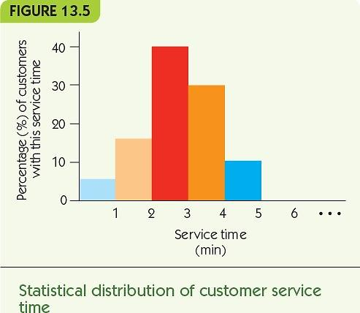
Computational Modeling (cont'd.)

Slide 16
Computational Modeling (cont'd.)
Example simulation: McBurger
To generate stochastic time:
Generate a value from distribution
Use that to generate a time
Uniform random number
Chosen randomly from a range of values
All values equally likely to be chosen

Slide 17
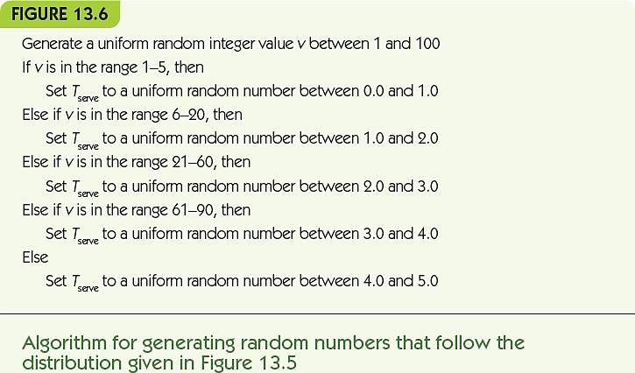
Computational Modeling (cont'd.)

Slide 18
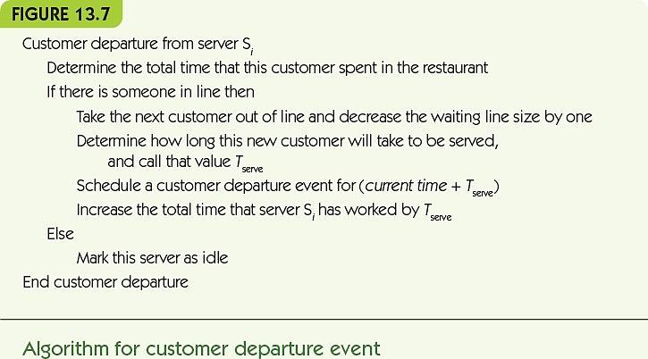
Computational Modeling (cont'd.)

Slide 19
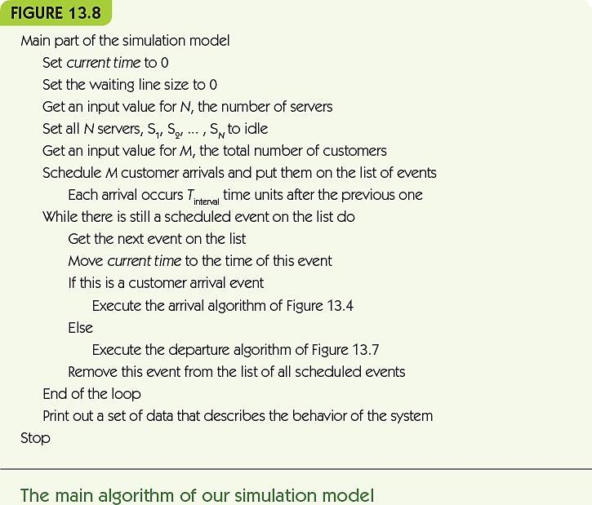

Slide 20
Computational Modeling (cont'd.)
Example simulation: McBurger
Outcomes: what data should be reported?
Average customer waiting time
Maximum length of waiting line
Server busy percentage

Slide 21
Running the Model and Visualizing the Results
Real-world models require many more computations
NERSC climate system model
10¹⁷ computations
Requires large parallel computer systems
Produces 500 million data values
Scientific visualization: methods for visualizing data to highlight important characteristics
Not computer graphics

Slide 22
Running the Model and Visualizing the Results (cont'd.)
Example 1: model of ocean tides
Produces predicted tide height for every 30 seconds of 24-hour day
Displays as a graph, easier to see features

Slide 23
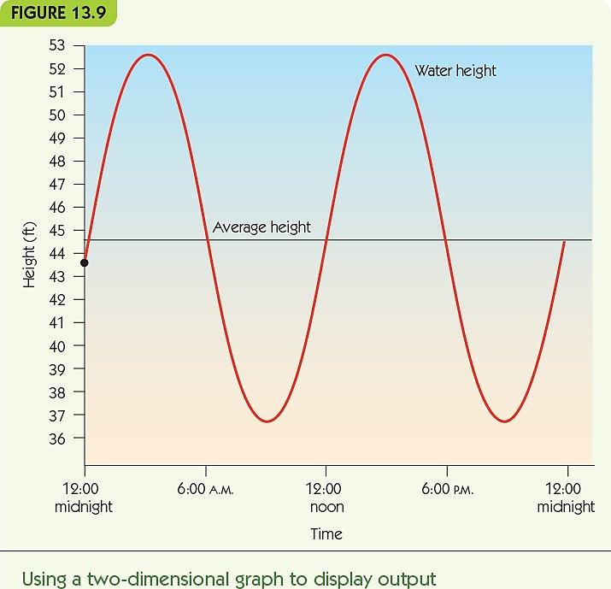

Slide 24
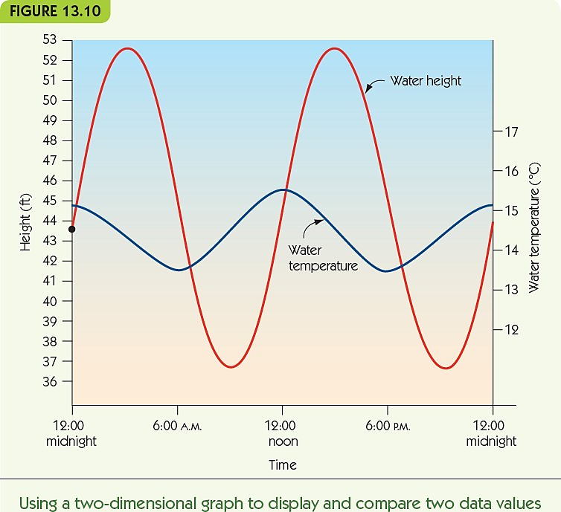
Running the Model and Visualizing the Results (cont'd.)
Example 2: model of tides and temperatures
Produces twice as much data
Displays both sets of data on one graph
Interactions become more evident

Slide 25
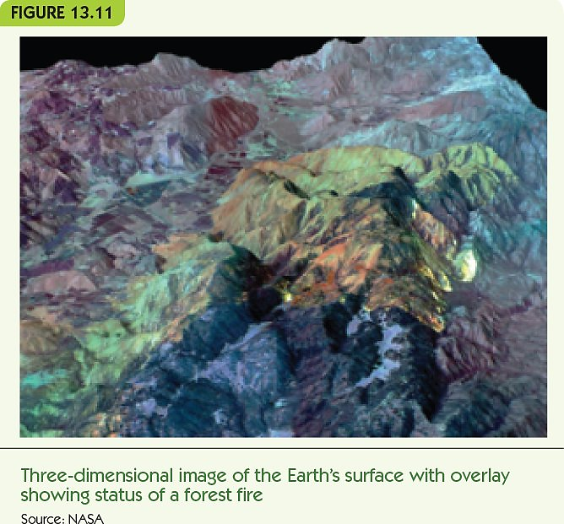
Running the Model and Visualizing the Results (cont'd.)
Example 3: model of forest fire intensity
Three-dimensional data and visualization
Hottest: yellow and red
Coolest: blue and green

Slide 26
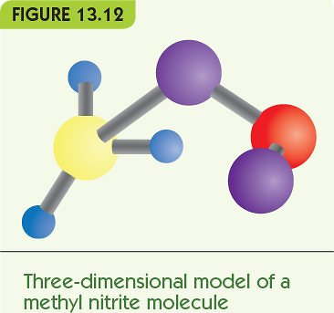
Running the Model and Visualizing the Results (cont'd.)
Example 4: model of chemical compound
Give 3-d display of atoms and chemical bonds
Can animate chemical reactions/changes
Use color and size to identify parts

Slide 27
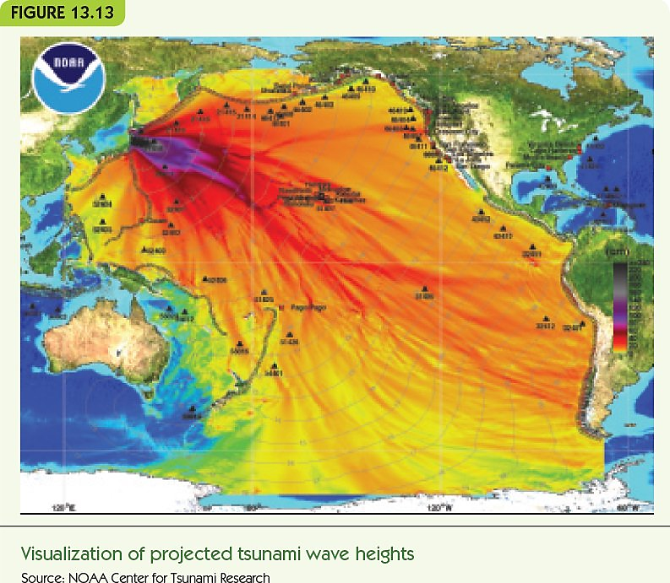
Running the Model and Visualizing the Results (cont'd.)
Example 5: model of tsunami waves
Color indicates wave heights
Purple = highest
Yellow = lowest
Integrated with map data

Slide 28
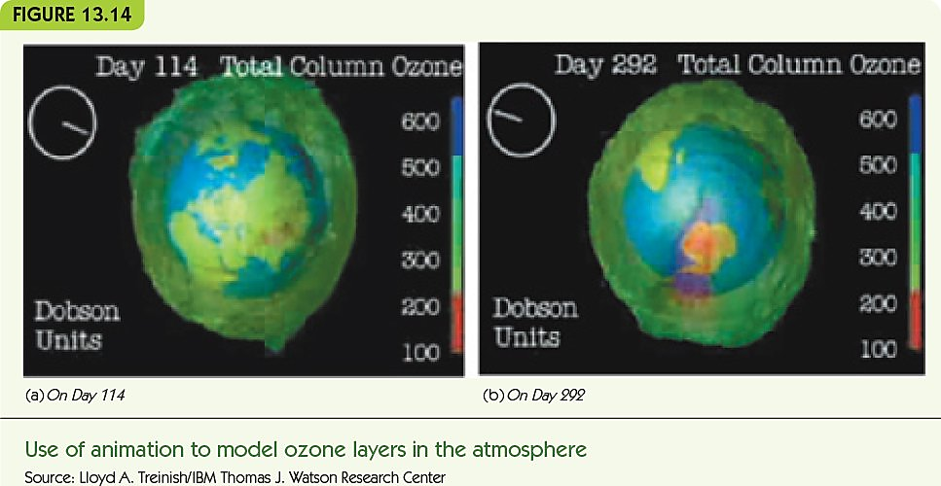
Running the Model and Visualizing the Results (cont'd.)
Example 6: model of atmospheric ozone over one year
Models where results appear over time
Image animation: a movie showing changes
One image per day
Colors indicate ozone amounts

Slide 29
Summary
Models are used to experiment with systems that are difficult or impossible to work with for real
Computational simulation models can be built and modified faster than physical models and can change the time or size scale to be more workable
Choose important features for accuracy; keep complexity manageable
Models may be discrete or continuous, deterministic or stochastic
Discrete event simulations jump from one event of a system to the next, skipping intervening time steps
Simulations like the McBurger example can be used to test the outcomes of design decisions
Some real-world simulations require massive computing resources
Data visualization makes model outcomes easier to understand

Slide 30
Exercise
Create the McBurger simulation algorithms with the following rules:
Instead of a single waiting line, define N waiting lines, one for each of the N servers in the restaurant;
The waiting line has a maximum length of MAX. If the length of the waiting line is currently less than MAX, then the customer gets into line in exactly the same way as described earlier. If the waiting line has a length equal to MAX, then the customer leaves the store without being served.
Each customer is assigned a priority when first entering the store (value from 1 to 10), and if there is no server currently available, the customer goes into the waiting line in priority order. That is, a customer gets into line ahead of all people with the lower priority and behind everyone with an equal or higher priority.

Slide 31
Chapter 15
Artificial Intelligence

Slide 32
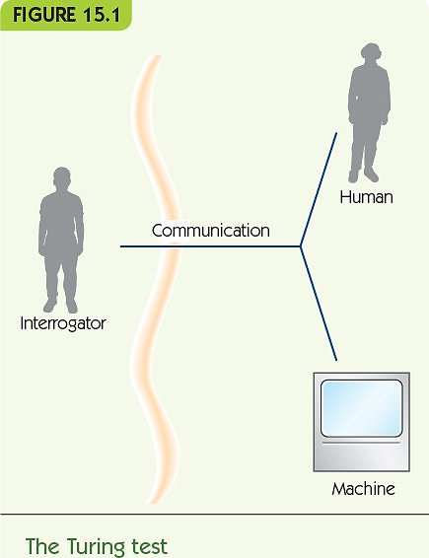
What is Artificial Intelligence?
Artificial Intelligence (AI): creating computer systems that exhibit aspects of intelligence
What is intelligence?
The Turing Test
Human judge questions two hidden entities
One entity is a person
One entity is a computer
If judge cannot distinguish computer from person, then computer is intelligent!

Slide 33
A Division of Labor
Computational tasks
Example: managing a payroll
Recognition tasks
Example: understanding the spoken word
Reasoning tasks
Example: planning your major in college

Slide 34
A Division of Labor (cont'd.)
Computational tasks
Typically have algorithmic solutions
Computers perform faster than humans
Computers perform more accurately than humans
Recognition tasks
Process massive amounts of sensory information
Access massive amounts of past experience
Require approximation
Humans perform much better than computers

Slide 35
A Division of Labor (cont'd.)
Reasoning tasks
Formal reasoning can be automated to some extent
Problems become intractable quickly
Common-sense reasoning
Requires great experience and knowledge

Slide 36
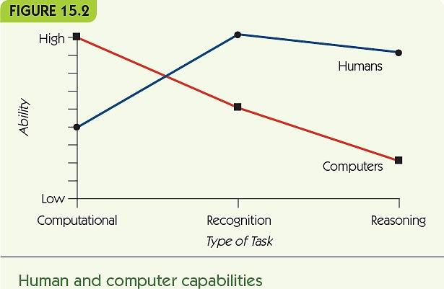
A Division of Labor (cont'd.)

Slide 37
Knowledge Representation
How can we represent knowledge for the computer?
Natural language
Use requires understanding of the meanings of words and combinations of words
“Spot is a brown dog”
“Every dog has four legs”

Slide 38
Knowledge Representation (cont'd.)
Formal language
Language of formal logic
“Spot is a brown dog” becomes
dog(Spot) AND brown(Spot)
“Every dog has four legs” becomes
For every x, if x is a dog then x has four legs
(∀x) dog(x) -> four-legged(x)

Slide 39
Knowledge Representation (cont'd.)
Pictorial representation
Knowledge as a digital picture
Cannot represent categorical information
Example: every dog has four legs
Graphical representation
Knowledge as nodes connected by edges
Semantic net
Nodes for objects or categories of objects
Edges for relationships
Nodes inherit features through “isa” relationships

Slide 40
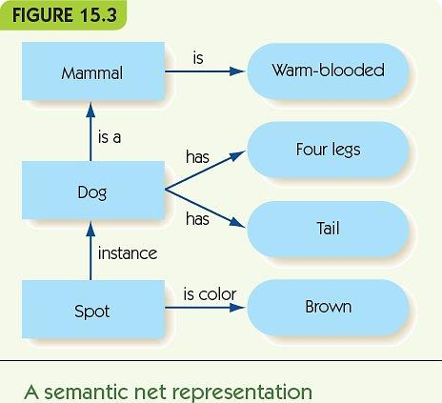
Knowledge Representation (cont'd.)
Note: remember this picture for the Object Oriented Programming class.

Slide 41
Knowledge Representation (cont'd.)
Requirements of a representation
Adequacy: must capture all relevant information
Efficiency: avoid redundant information
Extendability: easy to add new knowledge
Appropriate: easy to use for particular purpose

Slide 42
Recognition Tasks
Some AI work attempts to mimic the brain
Humans have 86 billion (10¹²) neurons
A neuron receives electrical stimuli from other neurons through dendrites
A neuron sends electrical stimuli through its axon
Signals pass through gaps, synapses
Some synapses cause increased activation; others inhibit activation
Neurons are like very simple computational devices

Slide 43
Recognition Tasks (cont'd.)
The nervous system is like a connectionist architecture
Processing arises from many simple processors with rich and complex connections
Processing in the brain occurs in a massively parallel way
Individual neurons are slow compared to computer computational speeds
Allows for redundancy and neuron failure (fault tolerant)

Slide 44
Recognition Tasks (cont'd.)
Artificial neural networks mimic the connectionist approach
Individual artificial “neurons” have:
A threshold for generating output
An activation level
Incoming weighted edges
Outgoing weighted edges

Slide 45
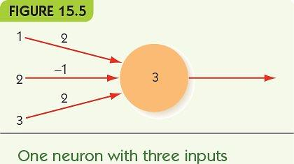
Recognition Tasks (cont'd.)

Slide 46
Recognition Tasks (cont'd.)
Neural networks are often organized into input and output layers
To provide an input to the network, fix the values of the input layer to 0 or 1
Output nodes compute weighted sum of all inputs

Slide 47
Reasoning Tasks Intelligent Searching
Decision tree represents possible next items for which to search
Linear search and binary search assume:
Data is organized linearly
Exact match is required
What if we relax the requirements?
What if data is not linear?
What if an approximate match is okay?

Slide 48
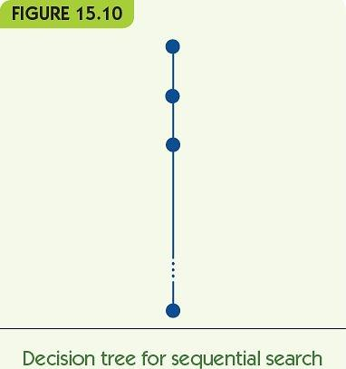
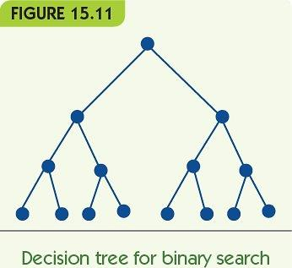
Reasoning Tasks Intelligent Searching (cont'd.)

Slide 49
Reasoning Tasks Intelligent Searching (cont'd.)
State-space graph
Each node is a state of our problem
A node connects to another if that state can be directly generated by the node
Examples: tic-tac-toe, eight-puzzle, maze-solving
Each node has many children
May be many paths to a goal
State-space search: seeks a path from start state to goal state

Slide 50
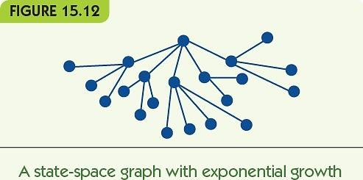
Reasoning Tasks Intelligent Searching (cont'd.)

Slide 51
Reasoning Tasks Intelligent Searching (cont'd.)
State-space graph
Each node is a state of our problem
A node connects to another if that state can be directly generated by the node
Examples: tic-tac-toe, eight-puzzle, maze-solving
Each node has many children
May be many paths to a goal
State-space search: seeks a path from start state to goal state

Slide 52
Reasoning Tasks Intelligent Searching (cont'd.)
Searching for a path to a goal
Brute force: trace all branches of decision tree
Too slow
Heuristics: use educated guess to guide which branches to search
Example: chess
Brute force is impossible
Good heuristics enable computers to play at grand master level
Chess is the last “easy” hard problem

Slide 53
Reasoning Tasks Swarm Intelligence (cont'd.)
Swarm intelligence model
Model communities of simple agents, e.g., ants, termites, etc.
Ant colonies
Individuals exhibit simple behaviors
Colonies accomplish great things
Finding the shortest path to food
Constructing nests
Ant colony optimization: route-finding using simulated ants

Slide 54
Reasoning Tasks Intelligent Agents (cont'd.)
Intelligent agent works with human user
Learns user’s preferences and takes actions on user’s behalf
Current examples
Personalized web search (push technology)
E-commerce site that tailors suggestions to your interests (recommendation software)
Future applications
Personal travel planner: buys tickets for user
Office manager: screens calls, arranges meetings

Slide 55
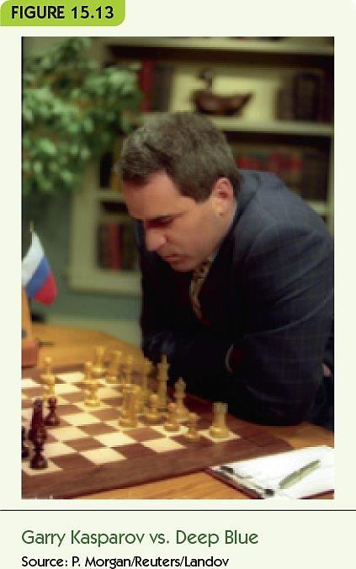
Reasoning Tasks The Games We Play

Slide 56
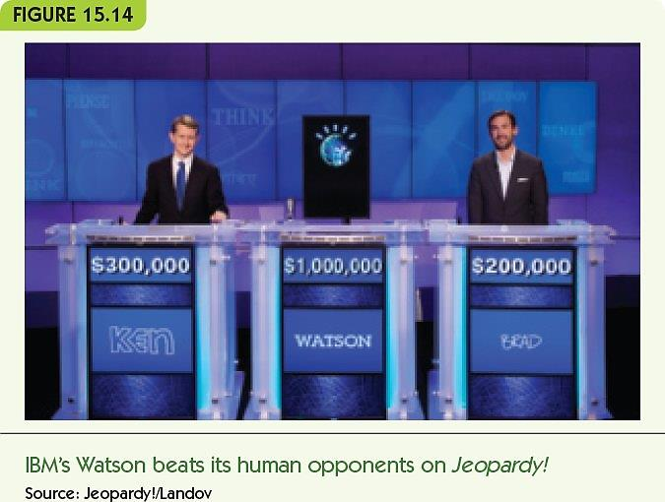
Reasoning Tasks The Games We Play (cont'd.)
Quiz games: Jeopardy!
Watson defeated Jeopardy! Champions (2011)
Given a quiz “answer” and category:
Applies multiple kinds of AI agents to search database (of information from the web)
Produces 300-500 candidate answers
Narrows to one answer and evaluates its certainty in real time
Scoring and evaluation are done in parallel

Slide 57
Robots and Drones
A robot is a physical device that takes in sensory data and makes autonomous responses
Current robot tasks
Repetitive or dangerous for humans
Manufacturing, bomb disposal, search-and-rescue
New research on multiple cooperating robots
Schools of robot fish for studying sea life
Swarms of robot flies for reconnaissance
Groups of robot snowmobiles to study climate change

Slide 58
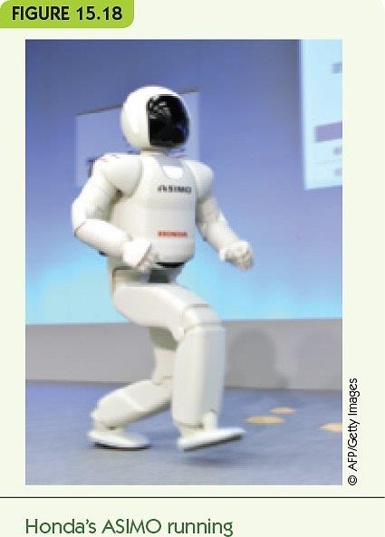
Robots and Drones (cont'd.)
Humanoid robots are designed for interacting with people
Help elderly or hospital patients
Monitor small children
Japan is a leader in humanoid robots
Aging population needs support
Asimo, by Honda
Designed to walk and move fluidly and robustly
Can open/close a door to go through, serve refreshments, etc.

Slide 59
Robots and Drones (cont'd.)
Deliberative strategy for robot control programs
Maintain detailed internal model of the world
Reason about sensory inputs and choose best response
Reactive strategy
Limit/eliminate internal model
React immediately to sensory inputs
Rapid cycle from inputs to responses to more inputs

Slide 60
Robots and Drones (cont'd.)
Drone
Unmanned Aerial Vehicle (UAV)
Controlled by a human at a remote site
Primarily used by military and law enforcement
Potential uses
Deliver medical supplies
Monitor dangerous situations, e.g. fires, floods, etc.
Document wildlife
Document urban traffic

Slide 61
Summary
Artificial intelligence programs solve problems in “intelligent” ways
Knowledge may be represented in many different ways; choice of representation depends on task
Neural networks simulate the connectionist structure of the nervous system
Neural networks are trained to produce the correct responses to inputs
Reasoning may often be state-space search

Slide 62
Summary (cont'd.)
Swarm intelligence uses colonies of simple agents to solve problems
Intelligent agents would be artificial personal assistants
Expert systems reason with expert domain knowledge
Game-playing is a common application for AI
Robots perform tedious and dangerous tasks
Drones are unmanned aerial vehicles

Slide 63
Chapter 16
Computer Graphics and Entertainment: Movies, Games, and Virtual Communities

Slide 64
Introduction
Early computers were too expensive and rare for use as entertainment (1950s-1960s)
When minicomputers arrived, college students began writing games for them (1970s)
Atari created Pong, first commercial game (1972)
Use in movies grew in early 1990s (Terminator 2, Jurassic Park)
Now entertainment is a huge, multi-billion dollar segment of the industry

Slide 65
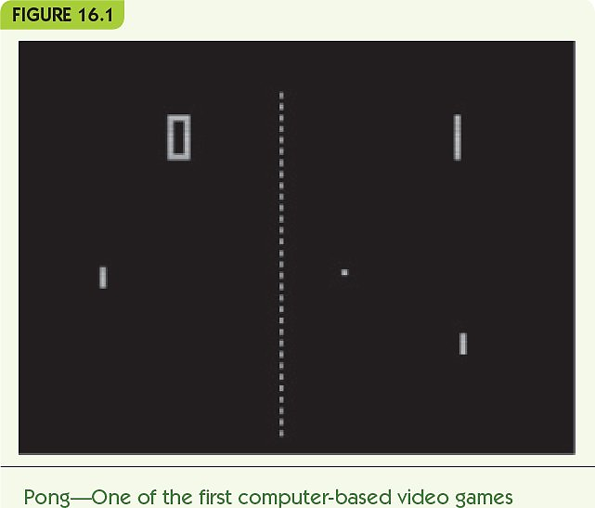
Introduction (cont'd.)

Slide 66
Computer-Generated Imagery (CGI)
Movie animation in the past
Hand-drawn (e.g., Walt Disney)
Stop-motion animation
Clay figures posed, photographed, then moved slightly
Computer animation developed in the 1980s and 1990s
Terminator 2: Judgment Day
Jurassic Park
Computer-generated imagery (CGI) produces photorealistic animation

Slide 67
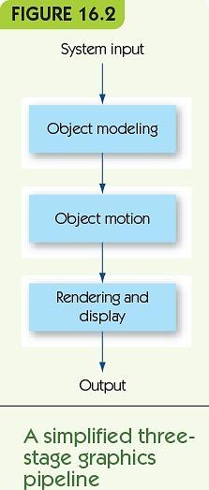
Computer-Generated Imagery (CGI) (cont'd.)
The graphics pipeline: sequence of tasks to generate CGI images/movies
Object modeling: create model of 3D object
Object motion: apply transformations to move objects
Rendering and display: incorporate lighting, shadows, and textures

Slide 68
Computer-Generated Imagery (CGI) (cont'd.)
Wireframe modeling is a common approach to object modeling
Take an image and create a tessellation
Divide object surface into planar polygons
Polygons share edges and vertices
Polygons completely cover object surface
Polygon mesh: result looks like a wire model
Convert to three dimensions
Generate a vertex list, a table of all vertices and their 3D position

Slide 69
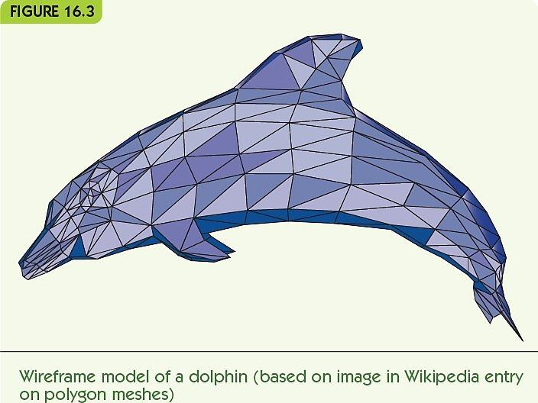
Computer-Generated Imagery (CGI) (cont'd.)

Slide 70
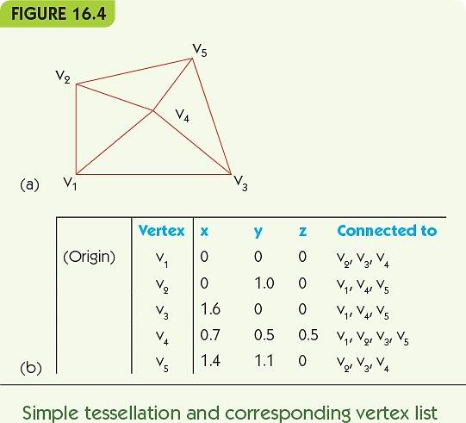

Slide 71
Computer-Generated Imagery (CGI) (cont'd.)
Object motion: rigid or deforming
Rigid motion: movement that does not change object’s shape
Translation: lateral movement, every point changes by the same amount in all three dimensions
Rotation: circular movement around a fixed point/axis
Reflection: mirror image of object

Slide 72
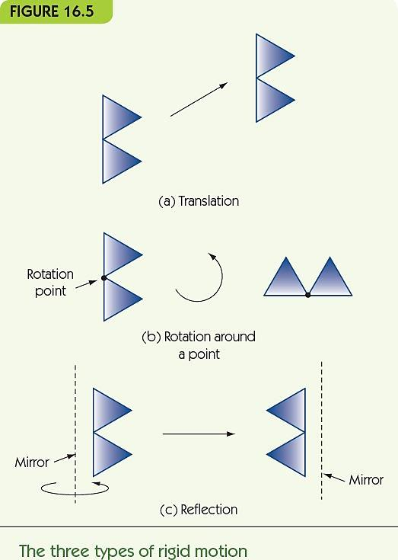

Slide 73
Computer-Generated Imagery (CGI) (cont'd.)
Implement movements using matrix multiplication
Transformation matrix
Defines a particular motion
Multiply vector for vertex position (x, y, z) by transformation matrix
Result is a new location for that point, as a vector
Example: move point at (x, y, z) to (x+a, y+b, z+c)
Create motion by repeating for small a, b, c
Keyframing: user gives start and end positions, computer generates the intermediate movements

Slide 74
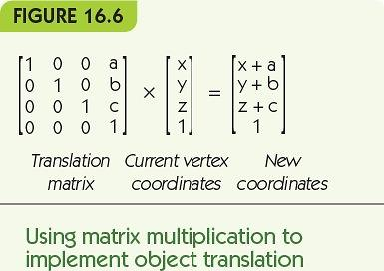
Computer-Generated Imagery (CGI) (cont'd.)

Slide 75
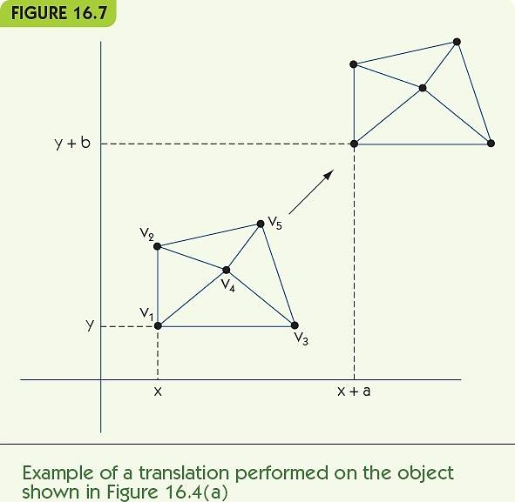
Computer-Generated Imagery (CGI) (cont'd.)

Slide 76
Computer-Generated Imagery (CGI) (cont'd.)
Control point (animation variable): a point or axis used to control motion
Multiple control points allow movement of parts of an object
Example: two rotation axes
One rotates right circle around center point
One rotates both circles around external point

Slide 77
Computer-Generated Imagery (CGI) (cont'd.)
Rendering: converting a model to a full 3D image
Lighting
Fix the location and intensity of all light sources
Determine the effects on objects
Color shading
Assign colors to vertices; blend across polygons
Shadows
Account for shadows from other objects
Texture mapping
Apply variable surfaces to polygons
Blur to show motion

Slide 78
Computer-Generated Imagery (CGI) (cont'd.)
Ray tracing: most common rendering algorithm
Repeats for each polygon in the object
For each light source, determine the amount and direction of light from that source
Combine light sources and determine intensity, color shading, brightness
Last step: convert 3D objects to a 2D image
Locate viewer; use geometry to determine the view

Slide 79
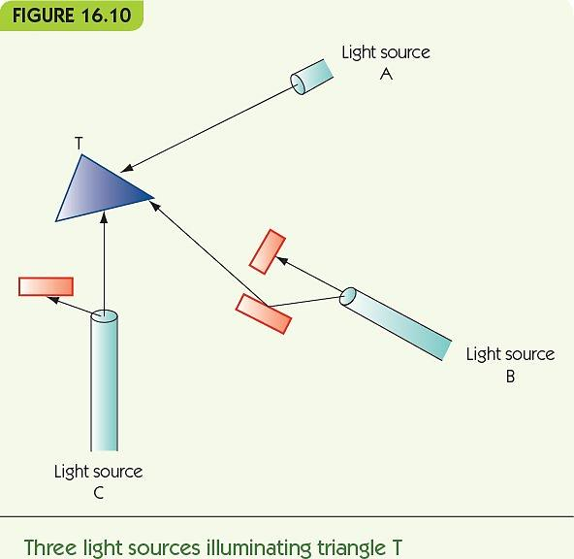

Slide 80
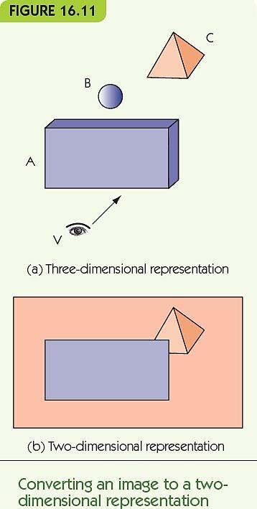

Slide 81
Video Gaming
Video game images are similar to CGI
CGI assumes a static environment
Unlimited time to produce the images
Created once and shown many times
Video games are a dynamic environment
User choices change what must be displayed
Must render images in real-time: real-time graphics
If necessary, sacrifice image quality
for speed of display

Slide 82
Video Gaming (cont'd.)
Frame rate: image generation speed
Computers improve frame rate with a GPU
Graphics processing unit (GPU)
A separate processor optimized for CGI
Dedicated video memory on a video card (graphics card)
Most contemporary computers have GPUs
Some have multiple GPUs

Slide 83
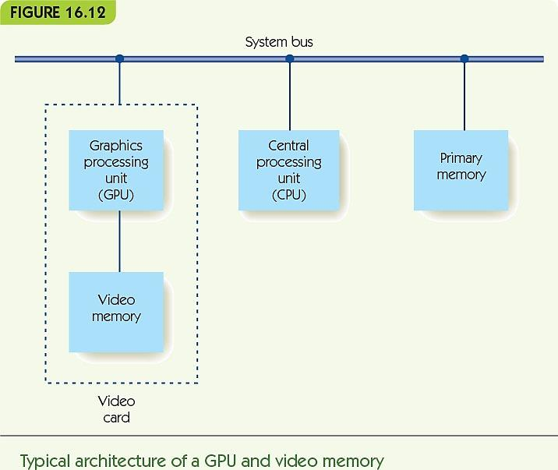

Slide 84
Video Gaming (cont'd.)
Other methods for achieving real-time graphics
Avoid time-consuming algorithms (e.g., ray tracing)
Use fixed colors, with no shadows or shading
Culling: first determine what is visible, and only render visible elements
Cut-ins: pre-computed fully-rendered objects
Stored in a video library
Dropped into the frame as needed

Slide 85
Multiplayer Games and Virtual Communities
Massively multiplayer online games (MMOG)
Thousands of players
Simulated virtual world
Example: World of Warcraft
Game provided by online game servers
Game world is always available and running
Users log into the game with client software

Slide 86
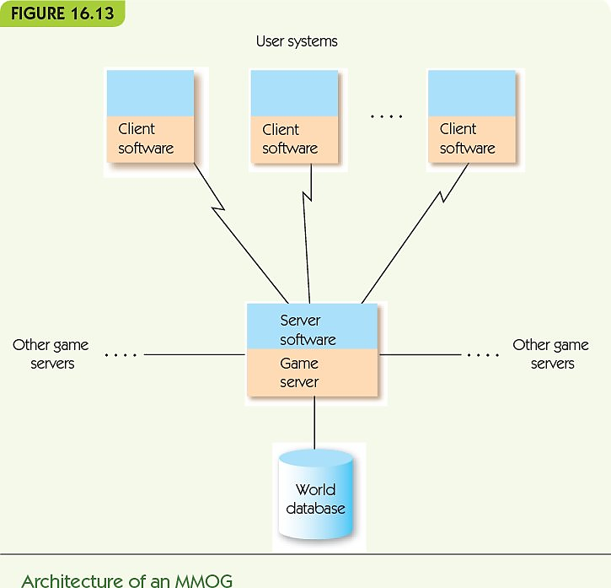

Slide 87
Multiplayer Games and Virtual Communities (cont’d.)
MMOG game designers must perform:
Game play management
Control game actions and render game images
Registration management
Control user accounts, new and returning users
Client/server protocols for multiple servers and thousands of clients
Security to ensure authorized access only
Database storage and retrieval
Store huge amounts of data, retrieve quickly

Slide 88
Multiplayer Games and Virtual Communities
Virtual communities:
Noncompetitive MMOG, or metaverse
Goal is not to score points or win, but to explore and interact, create, and engage in virtual commerce
Example: Second Life, by Linden Labs
Several thousand servers
100 trillion bytes of data
1 million active “residents”
~50,000 online at any one time

Slide 89
Summary
As computing power has grown, so has the use of computers for entertainment, games and movies
CGI allows for realistic animation
The graphics pipeline includes object modeling, object motion, and rendering and display
Objects are commonly modeled as tessellations of polygons in three dimensions
Motion is created through matrix multiplication of transformation matrices with vertices of an object

Slide 90
Summary (cont'd.)
Rendering must apply color, shading and texture to images
Ray tracing is a common technique for rendering
Video games must render images in real-time
GPUs perform video operations to speed up render time
MMOGs are online games, large scale computing
Virtual communities like Second Life are noncompetitive MMOGs

Slide 91
Exercises
Here is a vertex for a two-dimensional wireframe triangular model. Draw the two-dimensional figure modeled by this vertex list.
Vertex | X | Y | Connected to
V1 | 0 | 0 | V2, V3, V4
V2 | 0 | 1 | V1, V4
V3 | 1 | 0 | V1, V4, V5
V4 | 1 | 1 | V1, V2, V3, V5
v5 | 1.6 | 0.5 | V3, V4

Slide 92
Exercises (continued)
What was the name of the computer game that Atari released in 1974?
List at least three of the technical problems that must be solved by the designers of MMOGs.
Distinguish movies from video games in terms of their interactive environments.
Pick a computer game of your choice and describe its technical characteristics using the concepts learned in this class.

